Slide 1
X-sections KL & MN
See Cross section locations.kmz & Cross section labels.kmz for location in Google Earth

Slide 2
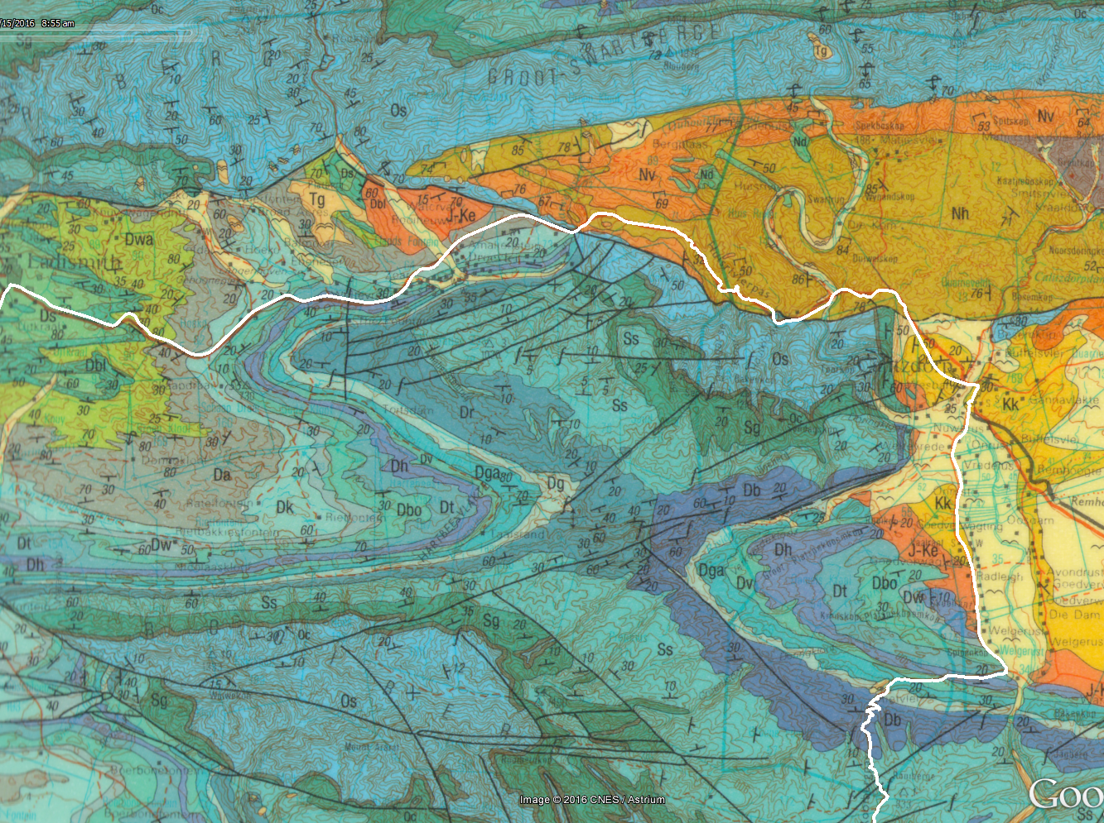
M
Ladismith
Zoar
Calitzdorp
K
L
N

Slide 3
Simplified Geologic Transverse Section MN
Herbertsdale March 2016 Project
Vertical Exaggeration ~ 2.7x
masl
Ss
1000
Dr
Os
Sg
Ss
Ss
Oc
Sg
0
Oc
Sg
Oc
Os
Oc
Os
-1000
Sg
Os
Nv, Nd & Nh
-2000
Undifferentiated Kango Group (Nv, Nd & Nh)
0
10
20
30
km
M
Longitudinal Section KL
N

Slide 4
Simplified Geologic Transverse Section NM
Herbertsdale March 2016 Project
Vertical Exaggeration ~ 2.7x
Ss
masl
Os
Dr
1000
Ss
Sg
Oc
Ss
Sg
Sg
Oc
0
Os
Oc
Os
Oc
Nv, Nd & Nh
Os
Sg
-1000
Undifferentiated Kango Group (Nv, Nd & Nh)
-2000
0
10
20
30
km
N
Longitudinal Section KL
M

Slide 5
Simplified Geologic Longitudinal Section KL
Herbertsdale March 2016 Project
Vertical Exaggeration ~ 2.7x
masl
1000
Dwa
Da
Dw
Dwu
Dk
Dw
Dbo
Dbo
0
Dt
Dh
Dt
Dh
Dga
Dv
Dv
Dg
Dg
Dga
Dr
Db
Ss
Ss
-1000
Sg
Oc
Sg
Oc
Os
Os
-2000
Nv, Nd & Nh
0
10
20
km
K
30
L
Longitudinal Section MN

Slide 6
Simplified Geologic Longitudinal Section LK
Herbertsdale March 2016 Project
Vertical Exaggeration ~ 2.7x
masl
Dwa
1000
Dwu
Dw
Da
Dk
Dbo
Dbo
Dw
Dt
Dh
Dt
0
Dv
Dga
Dh
Dg
Dg
Dv
Db
Dr
Dga
Ss
Ss
Sg
Oc
Sg
-1000
Oc
Os
Os
Nv, Nd & Nh
-2000
0
10
20
30
km
L
Longitudinal Section MN
K

